Slide 1


The A Team:
David Evans
Adam Driscoll
Josh Bennett
Joe Phaneuf
Henry Chen
GROUNDSBOT
The golf course mowing robot
Notes:
Good afternoon!
We are Team A...But you can call us the A-Team
Our team members are David Evans, Adam Driscoll, Henry Chen, Josh Bennett, and myself, Joe Phaneuf
Our gracious and steadfast sponsor is Discovery Robotics
Today we're going to introduce you to the future of autonomous grounds maintenance....
This. Is. GroundsBot!

Slide 2
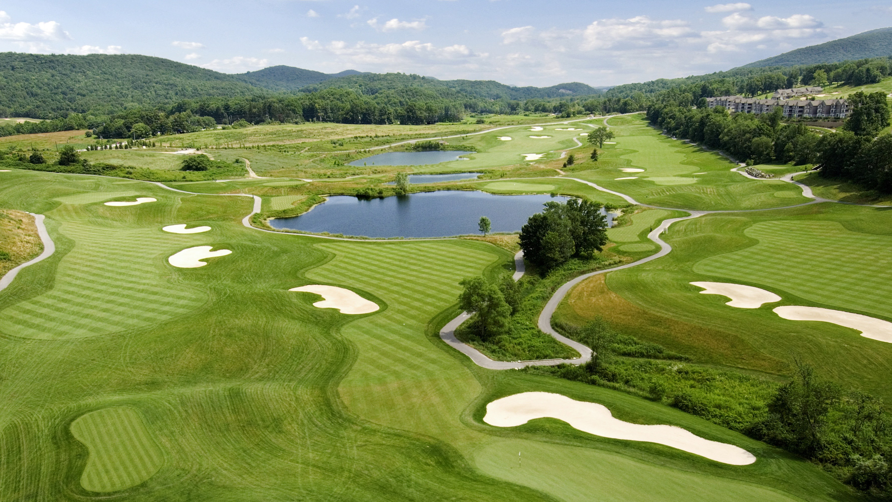
https://i2.wp.com/www.skydefproductions.com/wp-content/uploads/2014/09/7412-CS_Aerial071mw.jpg?fit=3560%2C2848
Notes:
https://i2.wp.com/www.skydefproductions.com/wp-content/uploads/2014/09/7412-CS_Aerial071mw.jpg?fit=3560%2C2848

Slide 3
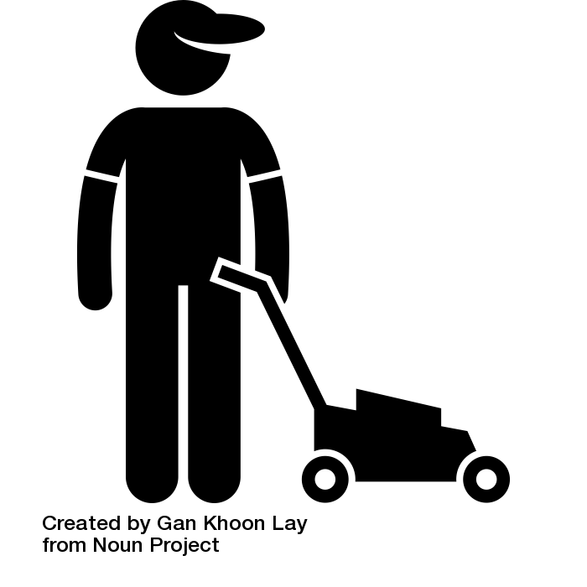
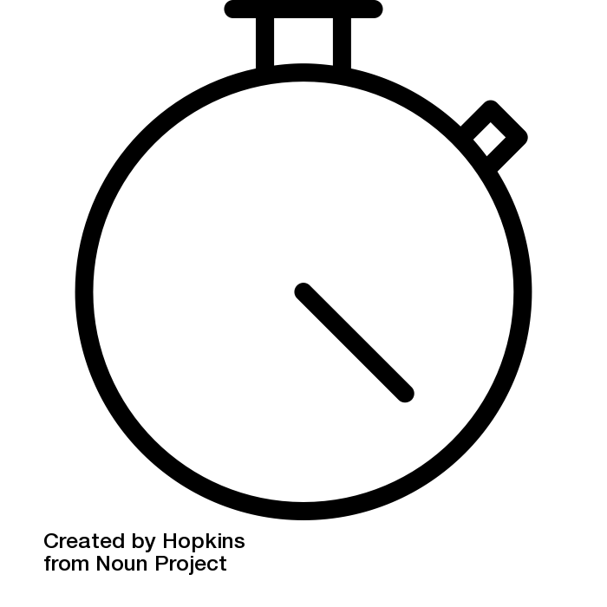
Notes:
What do groundskeepers want?
A beautiful course that attracts players and keeps them coming back
To do this they want to focus on fast greens, breathtaking fairways, grand scenery
This is a hard challenge because mowing the rough takes time ( 36% ofr groundskeepers time)
Mowing the rough requires a young, generalized workforce

Slide 4
We aim to deliver an autonomous mower that can be deployed to mow the golf course rough with minimal infrastructure

Slide 5
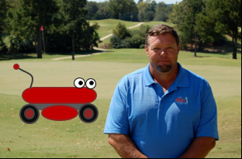
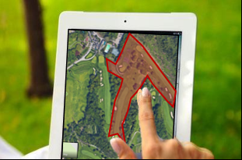
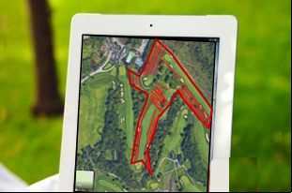
Use Case
GroundsBot is for golf course superintendents
like Steve
Steve first draws where he wants to mow and highlights zones for GroundsBot to avoid
The system plans a route to cover the outline and avoid obstacles

Slide 6
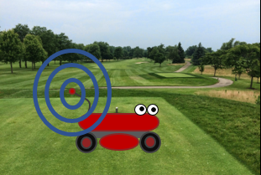
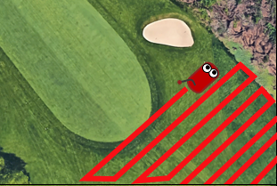
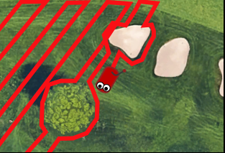
Use Case
GroundsBot receives the plan and localizes its position through GPS
The outline is mowed precisely, to the quality that Steve desires
Unplanned obstacles are detected and the mowing path is adjusted

Slide 7
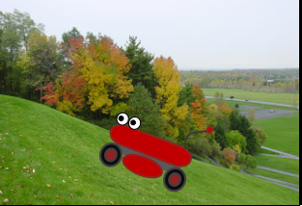
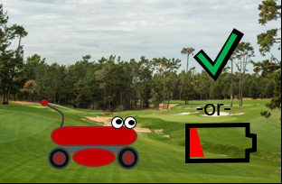
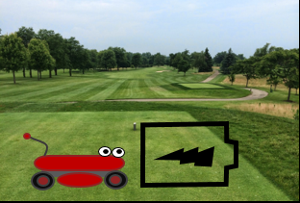
Use Case
Coverage is maximized by navigating steep hills
Once finished or low on power, GroundsBot returns back to its starting position
GroundsBot is recharged to prepare for more mowing

Slide 8
Functional Requirements
GroundsBot shall:
ID | Requirement
F.R.1 | Accept boundaries from user
F.R.2 | Cut the rough at desired quality
F.R.3 | Avoid obstacles
F.R.4 | Climb hills
F.R.5 | Return to home

Slide 9
Performance Requirements
GroundsBot will:
ID | Requirement
M.P.1 | First time user inputs map within 15 minutes
M.P.2 | System returns proposed route/coverage map within 5 minutes
M.P.3 | Cover 1/8 acre in 30 minutes on flat, unobstructed terrain
M.P.4 | Cut 0-25% overlap for 95% of grass
M.P.5 | Navigate 30 degree sloped grass
M.P.6 | Detect 80% of static objects greater than 3 inches in height and 2 inches in width
M.P.7 | Detect 80% of dynamic objects greater than 6 inches in height and 6 inches in width travelling less than 4 mph
M.P.8 | Mow to within 1 foot of detected obstacles
M.P.9 | Return home to within 5 feet of starting position
Notes:
Adam
Removed height requirement
Substantially reduced coverage area
Specified object detection rate and static vs dynamic
Removed feedback
M.P.4 – A complicated way of saying we’re going to zig-zag efficiently. If you think about the task of lawn mowing, you want some overlap to ensure you’re not missing any spots. But too much overlap and you’re being inefficient. So these numbers are trying to ensure we don’t miss anything but are still being efficient.

Slide 10
Non-functional Requirements
GroundsBot will:
ID | Requirement
M.N.1 | Have a functional and easily accessible emergency stop
M.N.2 | Be clearly visible
M.N.3 | Not tear up grass
Notes:
Adam
In our first attempt we approached it as GroundsBot the startup company. We’ve realized, while an educational experience, a lot of the NFRs we came up with weren’t relevant within the scope of the school project.
Pretty much all of the old ones are gone and these are the new ones.
Needs to be safe – don’t want to chop off limbs
Needs to be visible for safety as well
Needs to keep the grass in tact.

Slide 11
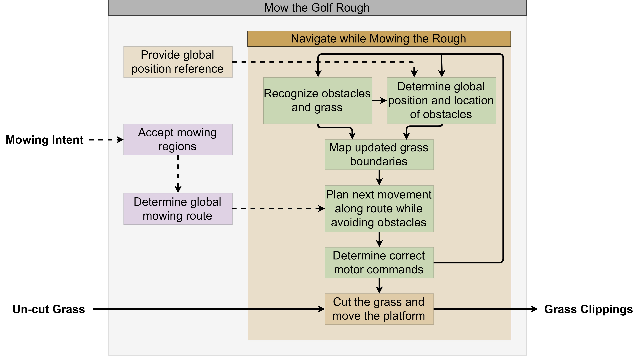
Functional Architecture
Notes:
3 main parts
Accept user intent
Determine strategy
Execute strategy

Slide 12
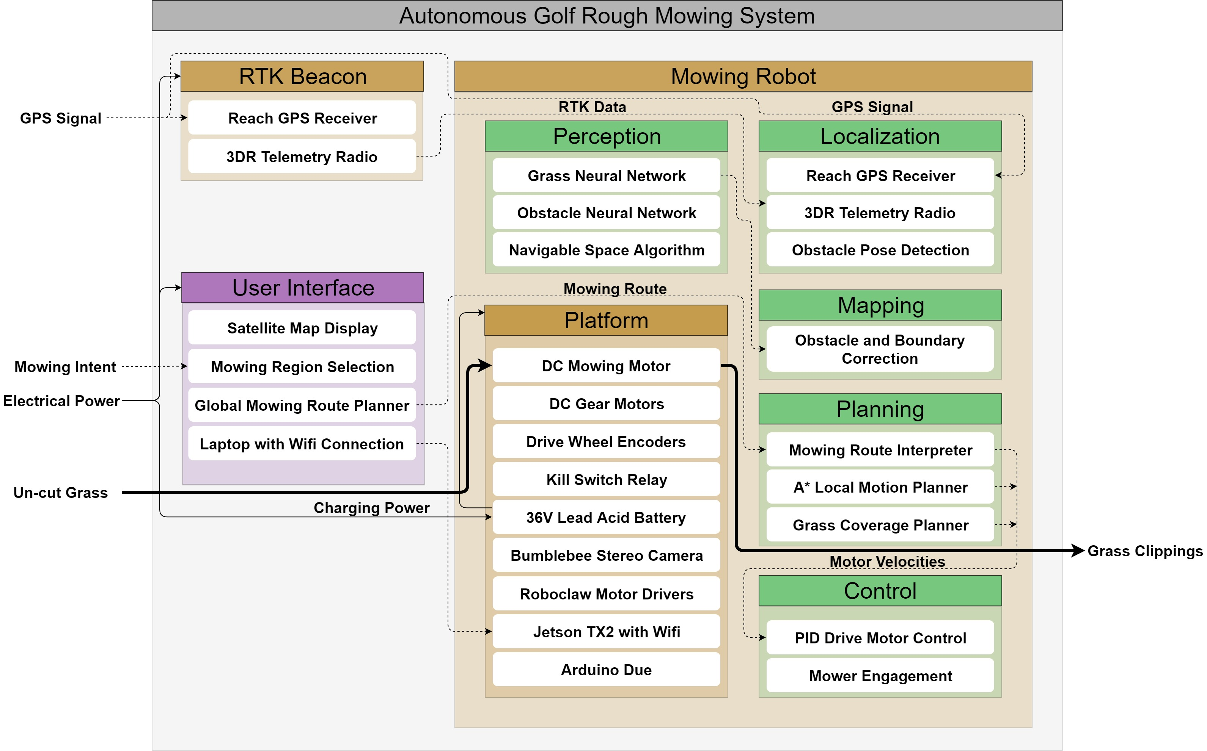
Cyber-physical Architecture
Notes:
Adding technology
GPS RTK
Google Earth UI
Neural net for robostats stereo arbiter takes in strategy and current status

Slide 13
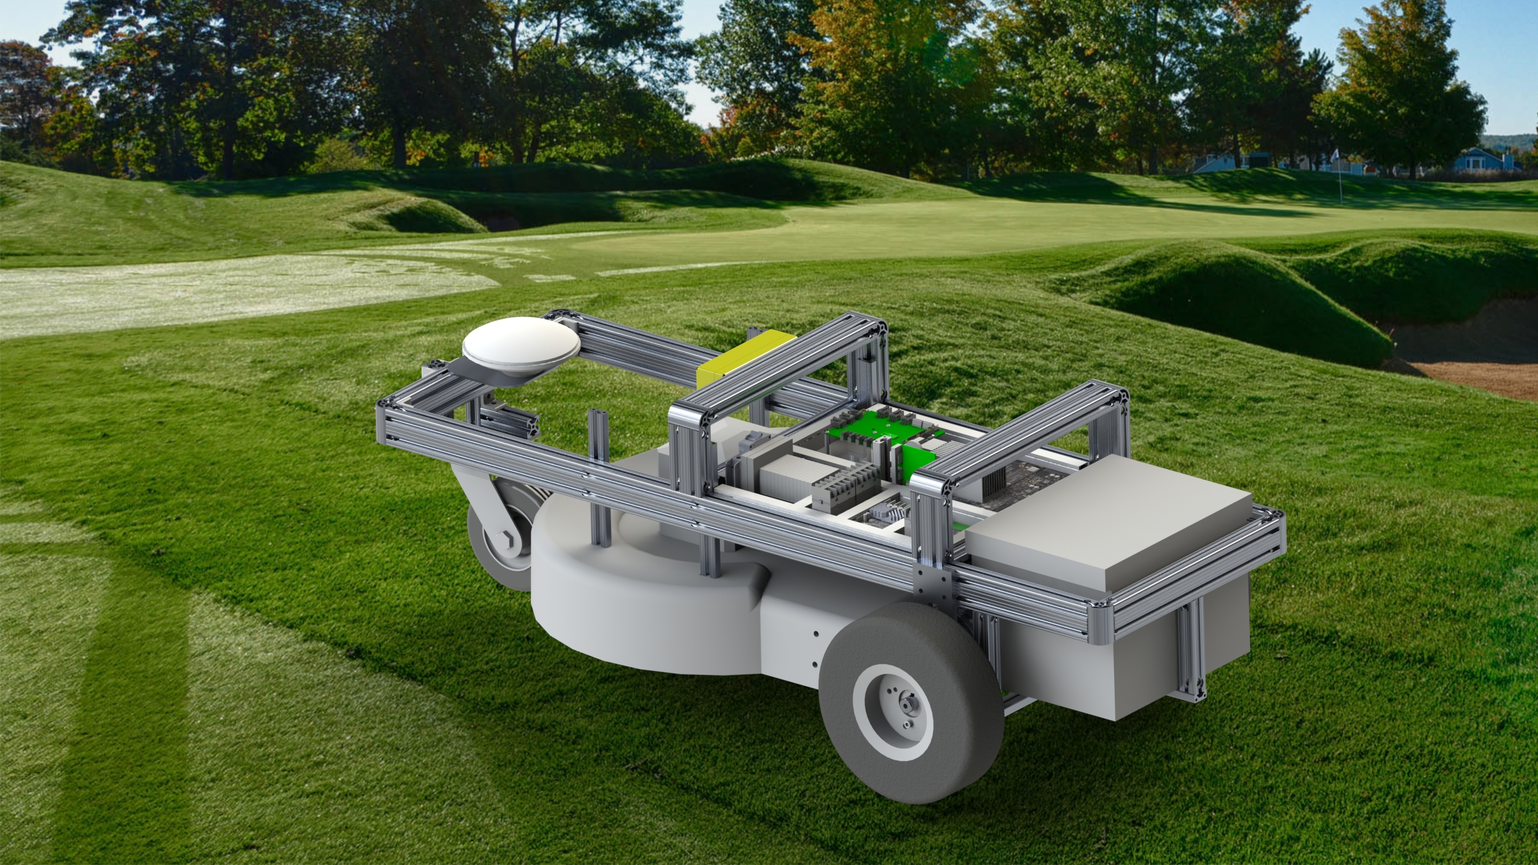
Overall System Description
Notes:
Josh

Slide 14
Key Subsystems
User Interface
Mowing Platform
Navigation
Perception & Mapping
Notes:
Josh

Slide 15
Targeted System Requirements
ID | Requirement | Fall Target
M.P.1 | First time user inputs map within 15 minutes | Google Earth generated FVE waypoints
M.P.2 | System returns proposed route/coverage map within 5 minutes
M.P.3 | Cover 1/8 acre in 30 minutes on flat, unobstructed terrain | Platform demo
M.P.4 | Cut 0-25% overlap for 95% of grass | Grass classification demo
M.P.5 | Navigate 30 degree sloped grass | Platform demo
M.P.6 | Detect 80% of static objects greater than 3”x2”x2” | Grass/paved classification demo
M.P.7 | Detect 80% of dynamic objects greater than 6”x6”x6” travelling less than 4 mph
M.P.8 | Mow to within 1’ of detected obstacles
M.P.9 | Return home to within 5’ of starting position | Platform/navigation demo
Notes:
Adam
Removed height requirement
Substantially reduced coverage area
Specified object detection rate and static vs dynamic
Removed feedback
M.P.4 – A complicated way of saying we’re going to zig-zag efficiently. If you think about the task of lawn mowing, you want some overlap to ensure you’re not missing any spots. But too much overlap and you’re being inefficient. So these numbers are trying to ensure we don’t miss anything but are still being efficient.

Slide 16
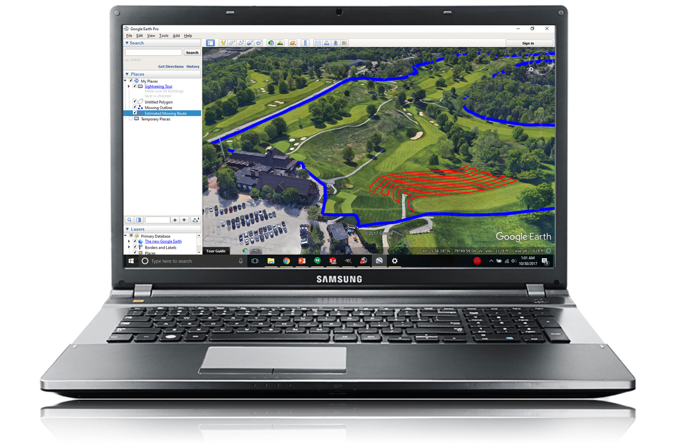
User Interface
Input:
Mowing intent from user
Output:
Planned mowing route
Mowing regions
Notes:
Josh

Slide 17
User Interface
Current Status:
KML export from Google Earth
Future Plans:
Send regions and route to GroundsBot via WiFi
Notes:
Josh

Slide 18
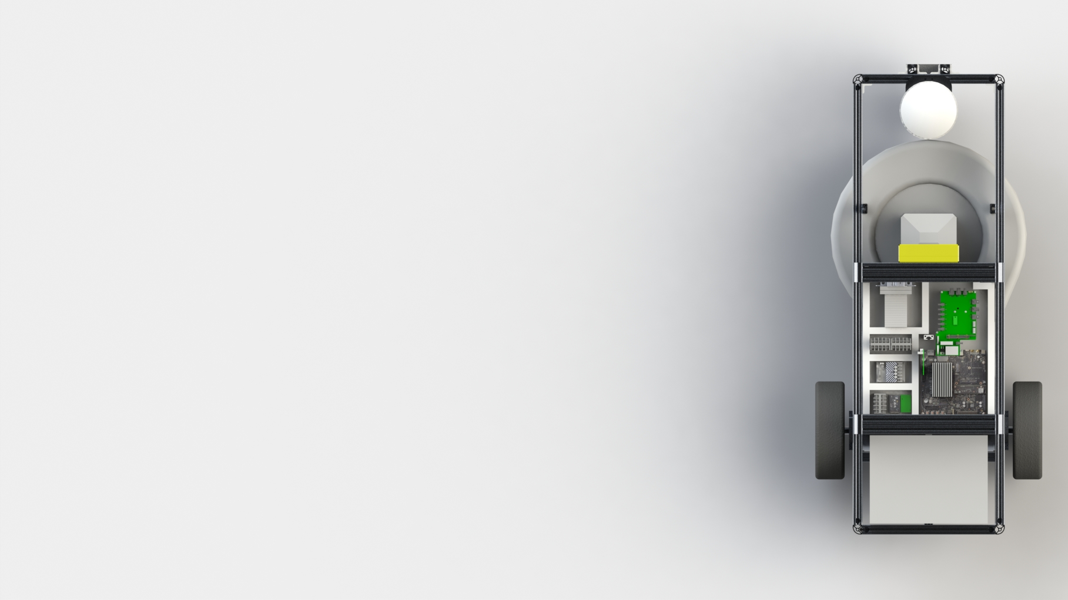
Mowing Platform
Input:
Motor commands from Arduino
Output:
Moving vehicle
Cut grass
Notes:
Josh

Slide 19
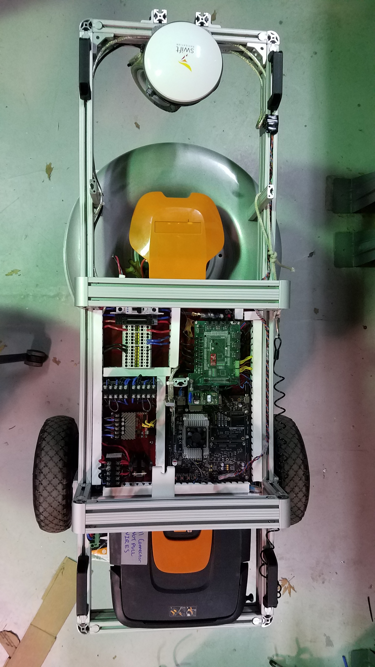
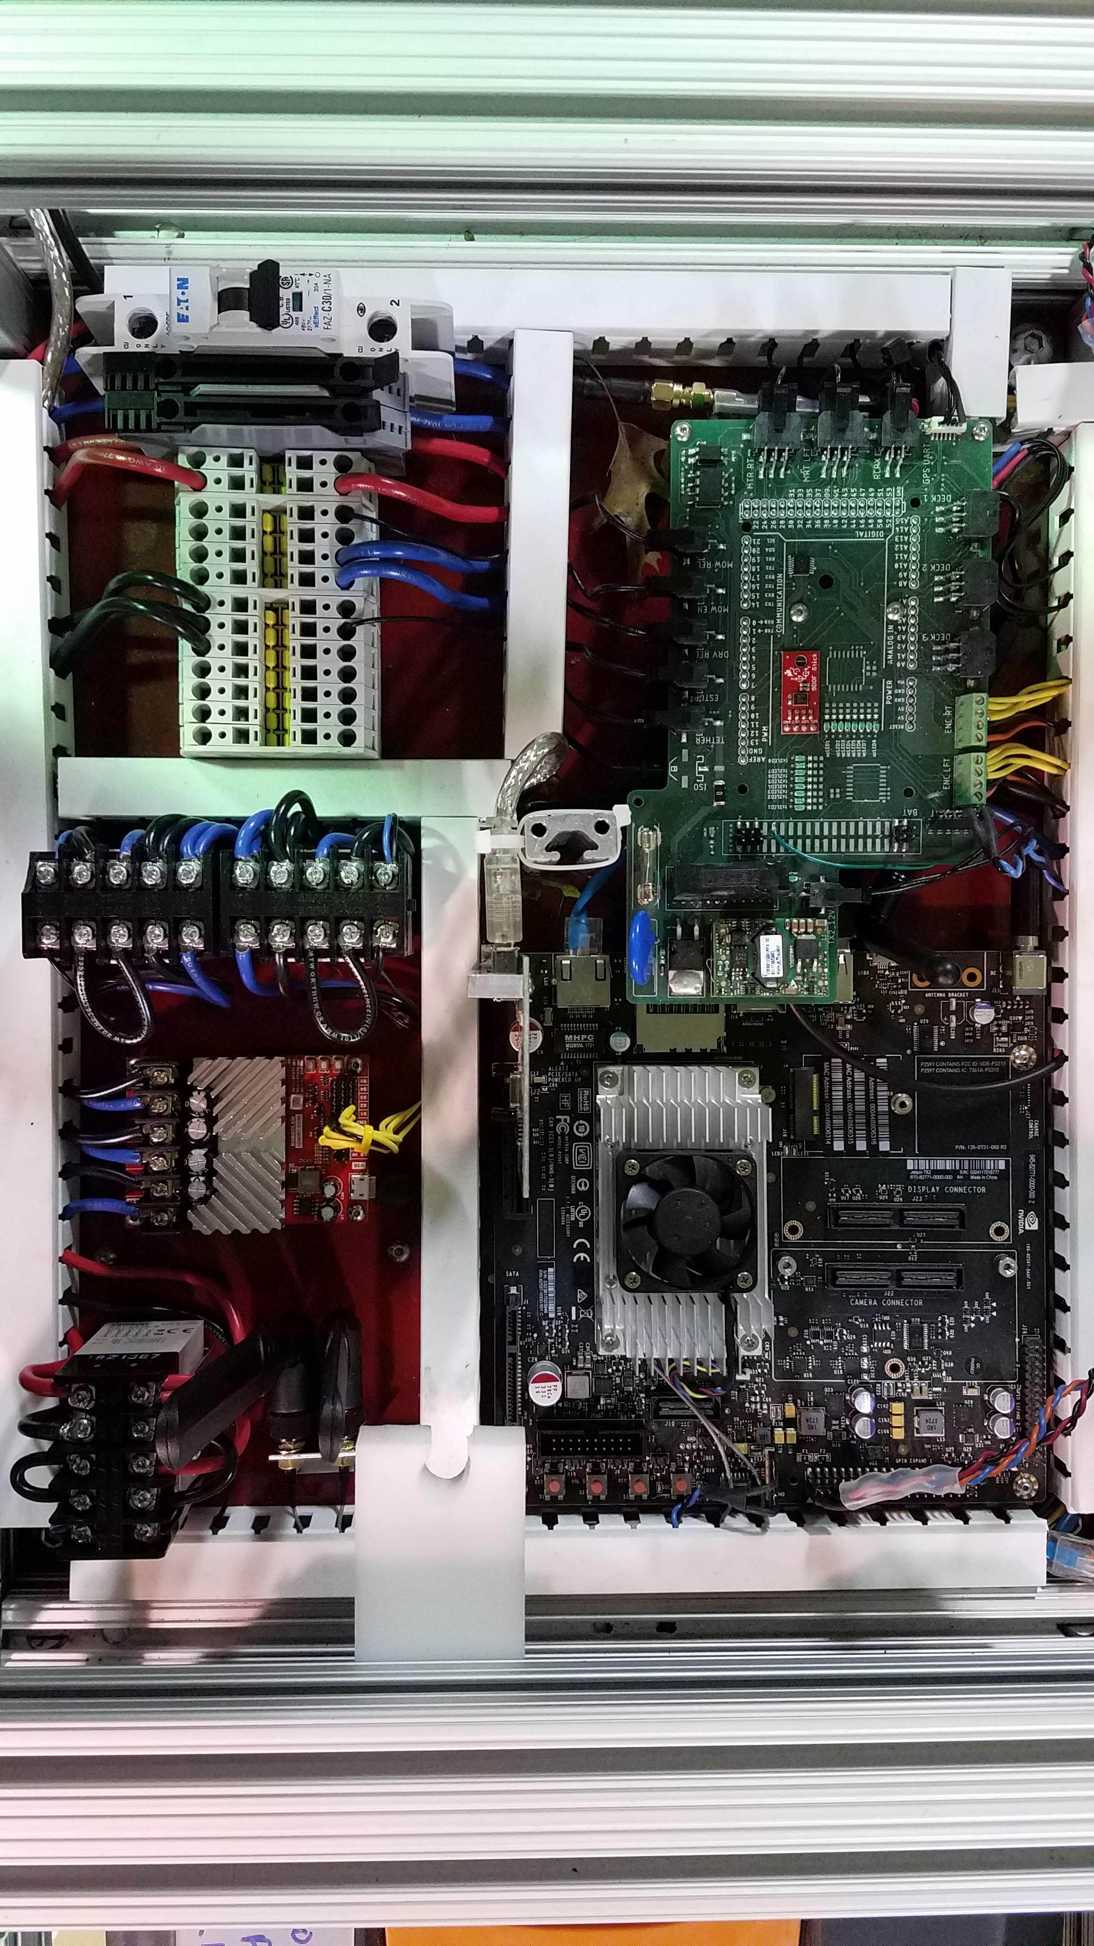
Mowing Platform
Current Status:
Chassis built
Motors attached
PCBA Integrated
Jetson Integrated
GPS Integrated
Future Plans:
Attach Bumblebee
Notes:
Josh

Slide 20
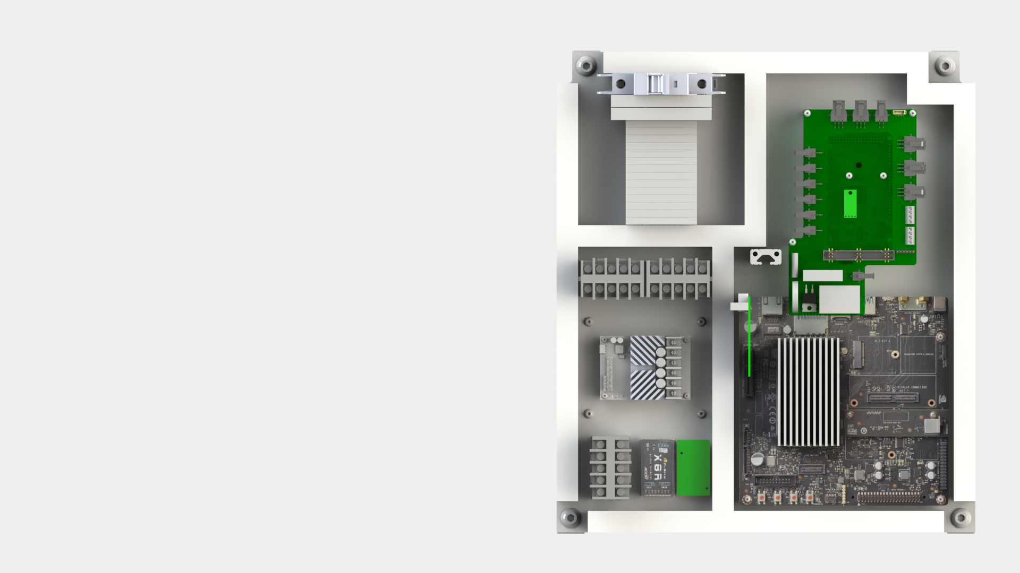
Mowing Platform - Electrical Panel
Fuses & Power
Arduino Mega, PCBA
E-Stop Relays
15A DC Motor Driver
Jetson TX2
Mower Relay
Notes:
Josh

Slide 21
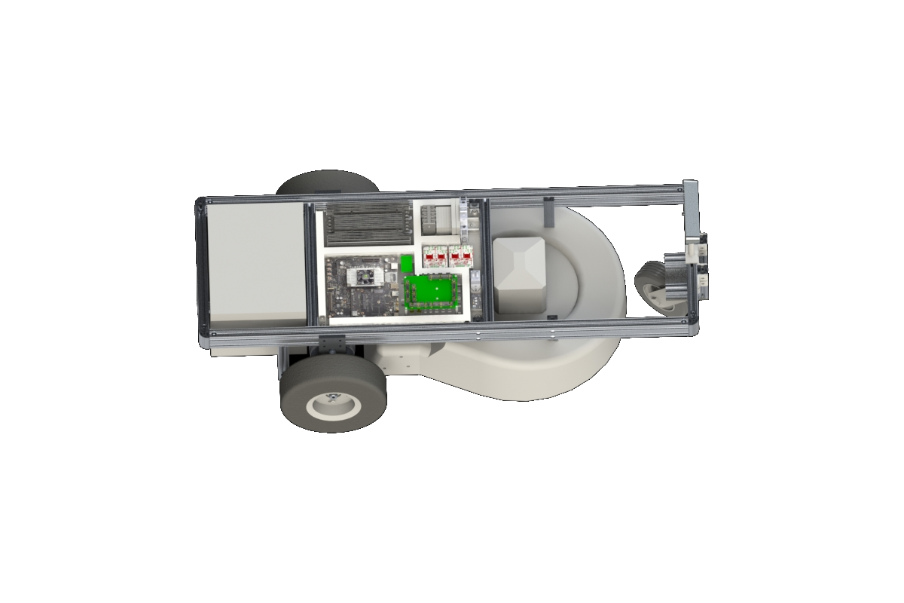
Navigation
Input:
Global position reference
IMU, odometry measurements
Map of relative world
Target mowing regions
Output:
Velocity commands to motor
Notes:
Adam
Moving on to our autonomy subsystems - Obviously GroundsBot will need to know where it is in the world so it will need a localization subsystem that can provide an accurate pose estimate

Slide 22
Navigation - Localization
Current Status:
Localization sensors integrated
ROS Localization stack integrated
IMU data processed with Complementary Filter
Sensor data processed through EKF
Future Plans:
Expand to dual EKF
Notes:
Adam
This is the current status the localization subsystem. We’re still in the acquisition phase. We have our encoders and RTK radios but are still waiting on the actual RTK. Once we get that we’ll begin working on our sensor fusion algorithm

Slide 23
Navigation - Planning
Current Status:
Processing set of waypoint input by user
Following waypoints
Future Plans:
Develop global coverage plan
Develop local obstacle plan
Notes:
Adam
Haven’t made any notable progress here yet. Working on getting the motors running. Future plans are to develop our planning algorithms and then make sure those are converted to valid motor commands to move GroundsBot.

Slide 24
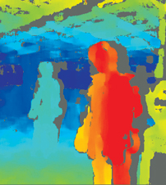
Perception & Mapping
Input:
Images of surrounding area
User defined boundaries
Current location
Output:
Relative object positions
Rough/Fairway edges
Refined map boundaries
http://aemstatic-ww2.azureedge.net/content/dam/VSD/print-articles/2014/11/1412VSD_ProdFocus_Fig1b.jpg
Notes:
Adam
Our system will take in a very rough map from the user so it will need to compensate for that with the perception and mapping subsystem. What this translates to is obstacle detection, grass detection, and user boundary refinement.
http://aemstatic-ww2.azureedge.net/content/dam/VSD/print-articles/2014/11/1412VSD_ProdFocus_Fig1b.jpg

Slide 25
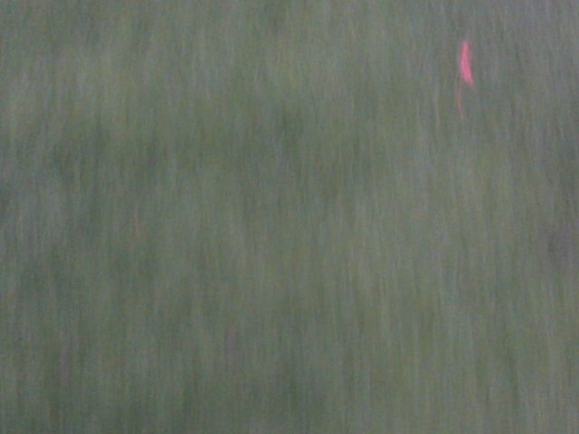
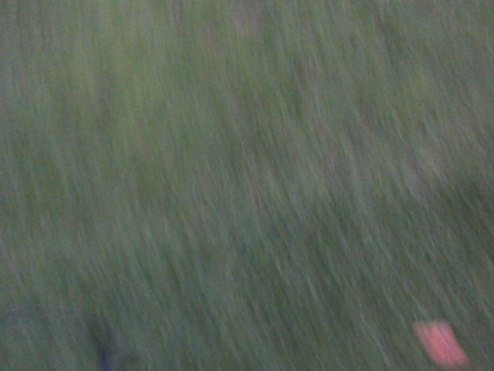
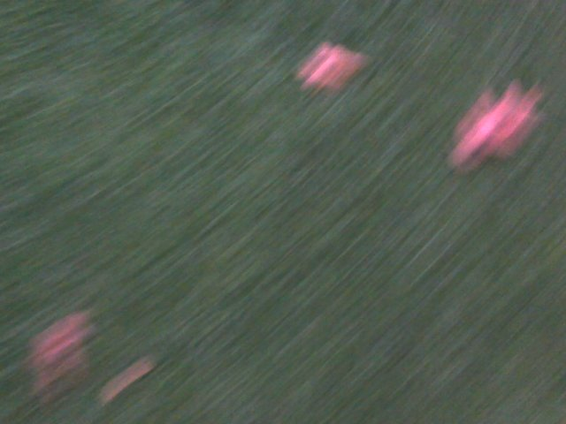
Perception & Mapping
Current Status:
Acquired Bumblebee
Grass classification working
fairway 0.997765
rough 0.0022350
Future Plans:
Integrate Bumblebee
Object detection
Build map from user/sensor input
rough 0.849928
fairway 0.150072
rough 0.999997
fairway 2.58e-06
Notes:
Adam
Currently, we have acquired the bumblebee. We have also successfully trained a neural network to classify grass types. These are a couple of our results. The top photo is all fairway, the bottom photo is all rough, and the middle photo is actually mixed – as you can see the classification results accurately reflect what’s in the images. This will actually be implemented as an online learning so pre-training won’t actually be needed.
Future plans of course are to integrate the bumblebee, get object detection working, and work on a map refinement algorithm

Slide 26
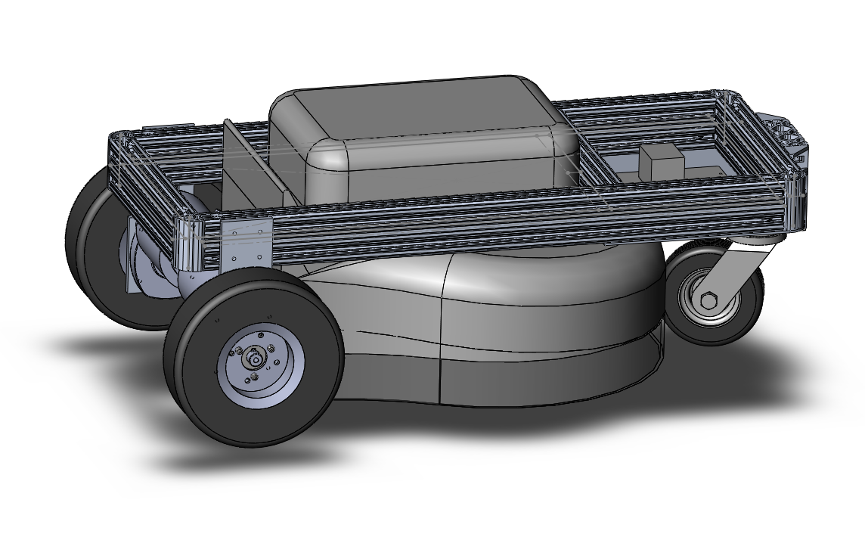
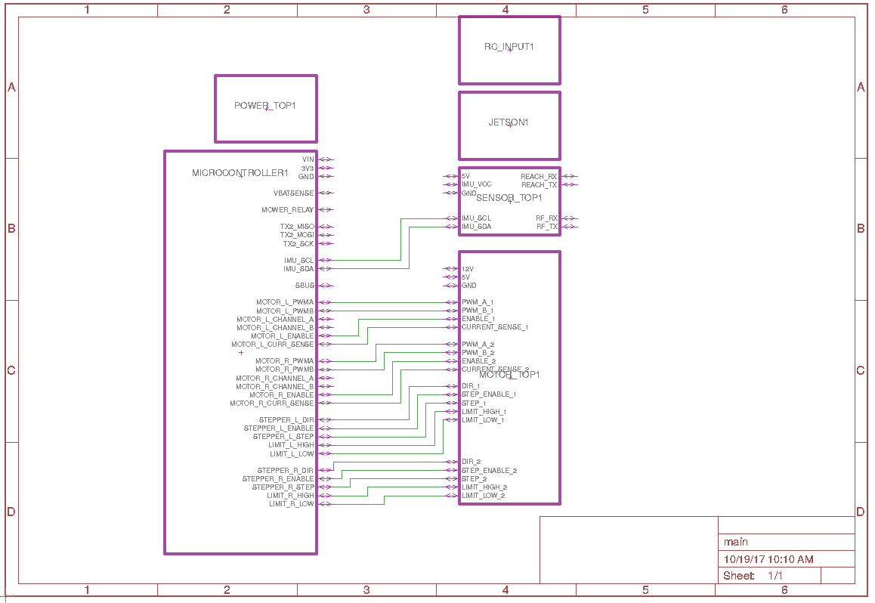
Modeling, Analysis, Testing
Platform
Constructed CAD models
Performed Excel analysis for expected performance
Unit tested PCB while building
Spice simulations for UVLO and relay drive
Navigation
Individually tested RTK GPS accuracy
Used simulator to test localization and planner
Perception
Tested accuracy on 7 different datasets

Slide 27
Fall Validation Experiment Performance
1. GroundsBot waypoint navigation
2. Sidewalk vs. grass classification
3. Emergency stop

Slide 28
FVE 1 Performance
Goal:
Test GroundsBot's ability to repeatedly navigate with GPS
Success Condition:
Navigate within 2ft of each waypoint
Result:
6” average error
Notes:
Adam
Haven’t made any notable progress here yet. Working on getting the motors running. Future plans are to develop our planning algorithms and then make sure those are converted to valid motor commands to move GroundsBot.

Slide 29
FVE 2 Performance
Goal:
Test the fairway vs. rough classification algorithm
Success Condition:
Classification accuracy > 90%
Result:
91.8% total accuracy
Notes:
Adam
Haven’t made any notable progress here yet. Working on getting the motors running. Future plans are to develop our planning algorithms and then make sure those are converted to valid motor commands to move GroundsBot.

Slide 30
FVE 3 Performance
Goal:
Test GroundsBot’s ability to stop in case of emergency
Success Condition:
Stop within 2 seconds
Result:
Stops immediately
Notes:
Adam
Haven’t made any notable progress here yet. Working on getting the motors running. Future plans are to develop our planning algorithms and then make sure those are converted to valid motor commands to move GroundsBot.

Slide 32
FVE Conclusions
Strengths
Platform operates consistently Able to navigate within 2ft consistently Several layers of safety
Weaknesses | Improvement Area
Cannot navigate to waypoints within 1 meter of each other | Improve trajectory planner and convert single EKF to global and local EKF
Waypoints drift over time | Create permanent RTK mount
Motor power ring terminals wear and snap over time | Switch to stronger ring terminals

Slide 33
Work Breakdown Structure
Platform
Navigation
Perception
UI
Management
Chassis
Localization
Stereo-cam
integration
Map interface
Schedule
Sensor integration
Electronics
Obstacle Detection
Integration w/ coverage plan
Finance
Kalman Filter
Low-power
Static
Risk
High-power
Planning
Dynamic
Control
Coverage plan
Personnel
Map creation
Trajectory plan
Notes:
Joe
Things….ar
What’s good:
MVP app output: google earth
Firmware outlined
Electronics Design is complete
Chassis design and assembly complete
Grass type classifier alive and well
Under motor control, GroundsBot moves as most of you have witnessed
Management is ever evolving, but we feel we have a solidgrasp on our schedule, finances, risk and personnel
What’s in the red:
Electronics integration will occur starting today as PCBs arrive
App integration: For the purpose of FVE, this is an mvp, and is low-risk
What’s in Orange:
One FVE test makes use of the App output, we will be testing that integration once other systems are integrated
Motion planners, gps, odometry, and driver development are all in progress, coming along nicely

Slide 34
Fall Schedule
​X = Targeted Schedule, Green = Actual Completion | Nov 3 ​ | Nov 10​ | Nov 17 ​ | Nov 24 ​ | Nov 30​
Grass Classification​ | X | ​ | ​ | ​ | ​
Chassis Assembled​ | ​ | X | ​ | ​ | ​
Integration PCBA Ordered​ | ​ | X | ​ | ​ | ​
Local Motion Planner Complete |  |  | X
Electronics Integrated​ | ​ | ​ | X | ​ | ​
UI MVP App Complete​ | ​ | ​ | X | ​ | ​
Firmware Wrappers Complete​ | ​ | ​ | X | ​ | ​
RTK Integrated​ | ​ | ​ | X | ​ | ​
Systems Tests Complete​ | ​ | ​ | ​ | X | ​
FVE​ | ​ | ​ | ​ | ​ | X

Slide 35
Spring Schedule
​​X = Targeted Schedule | Late Jan. | Mid Feb. | Late Feb. | Mid Mar.​ | Early Apr. | Mid Apr. | End Apr.
Refined Simulation with Camera | X
BumbleBee Integration | X
Obstacle/Planning Architecture | X
Global Planner |  | X
Static Obstacle Detection |  |  | X
Local Planner |  |  |  | X
Dynamic Obstacle Detection |  |  |  |  | X
App Integration |  |  |  |  |  | X
SVE |  |  |  |  |  |  | X

Slide 36
Spring Test Plan
Progress Review | Milestone | Demonstration
PR7 | GroundsBot streams data from stereo camera GroundsBot simulation uses stereo camera data Obstacle detection ROS architecture defined | Video: simulation utilizing bagged camera data Image: rqt_graph
PR8 | GroundsBot global planner complete | Video: User defined shape converted to mowing plan
PR9 | Static obstacle detection | Video: GroundsBot detects object and stops
PR10 | Local planner complete | Video: GroundsBot detects object and routes around object
PR11 | GroundsBot detects dynamic obstacle | Video: GroundsBot detects moving object and stops
PR12 | GroundsBot deployable from app | Video: GroundsBot completes mission launched from app

Slide 37
Spring Validation Experiment
1. Navigation/obstacle avoidance test
2. Dynamic obstacle test
3. Hill climb test

Slide 38
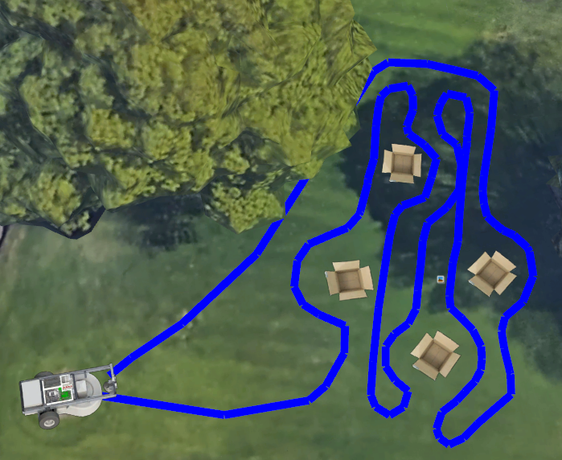
SVE Test 1
Location: Field by Doherty Apartments
Equipment | Procedure
GroundsBot Base Station Laptop 4 obstacles greater than 3”x2”x2” 1 obstacle 3”x2”x2” | Open UI mobile interface, have a new user define boundaries of area to be mowed Place 5 obstacles in defined mowing area Submit plan to GroundsBot Run GroundsBot
Criteria
M.P.1: First time user inputs map within 15 minutes M.P.2: System returns proposed route within 5 minutes M.P.3: Cover 1/8 acre in 30 minutes M.P.4: Cut 0-25% overlap for 95% of grass M.P.6: Detect 80% of static objects > 3”x2”x2” M.P.8: Mow to within 1’ of detected obstacles M.P.9: Return home to within 5’ of starting position

Slide 39
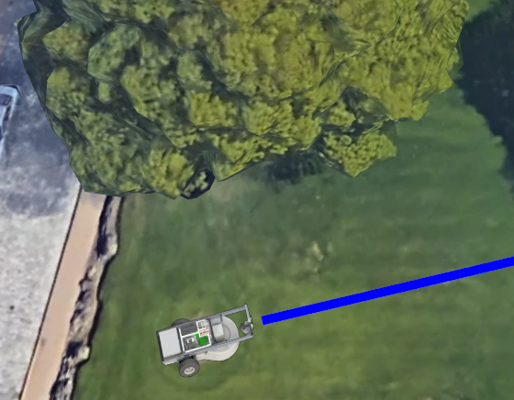

SVE Test 2
Location: Field by Doherty Apartments
Equipment | Procedure
GroundsBot Base Station Laptop Soccer Ball | Direct GroundsBot to move in a straight line Throw a soccer ball in front of GroundsBot 5 times
Criteria
M.P.7: Detect and avoid 80% of dynamic objects greater than 6”x6”x6” travelling less than 4 mph

Slide 40
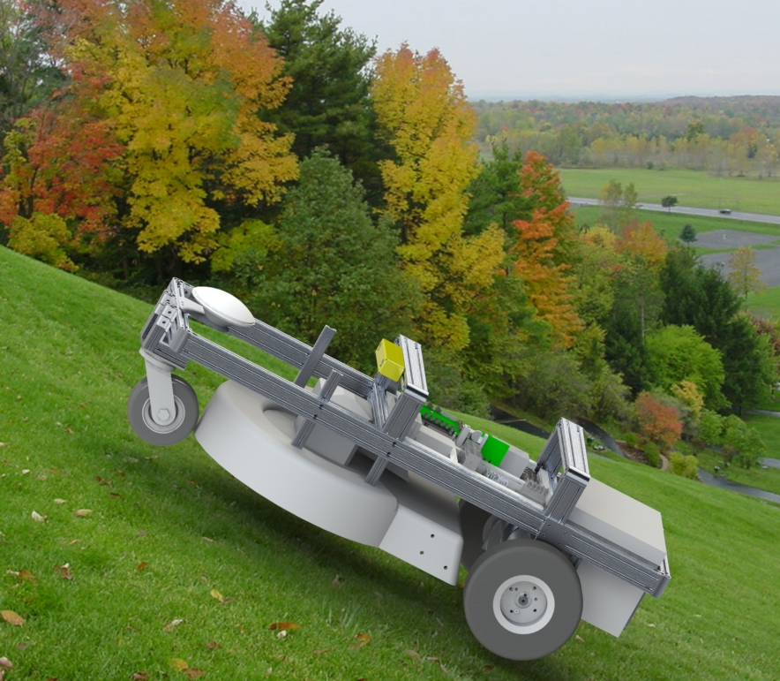
SVE Test 3
Location: Offline, video with measurements presented for SVE
Equipment | Procedure
Monitor Laptop Remote Control | Manually control GroundsBot on a hill by driving up the hill
Criteria
M.P.5: Navigate 30 degree sloped grass

Slide 41
Budget
Total Budget | $5,000
Grand Total | $3959.22 (79%)
Remaining Budget | $1040.78
Chassis | $854.28
REACH RTK Kit | $570.00
Nvidia Jetson TX2 | $300
Electric Mower | $289.33
GNSS Antennas (2x) | $390.00
Spare 36V Lead Acid Batteries (2x) | $279.98
Roboclaw Motor Drivers (2x) | $179.90

Slide 42
Risks
ID | Risk | Description | Prob | Critical Level | Mitigation
1 | Unplanned electro-thermal events | Fire or explosion due to mis-handling of batteries | 1 | 3 | Don’t connect batteries in parallel without load balancing. Spare batteries ordered
2 | No permanent rtk mount | The position of the base station moves from day to day | 1 | 1 | Visit test site ahead of time and establish a repeatable location for RTK placement
3 | Damage to GPS units - long lead time | GPS comes on a boat from China | 2 | 4 | Electrical and mechanical protections
4 | RTK not getting fix | GPS signal is attenuated or noisy | 3 | 4 | Find a better antenna
5 | Incompatible Jetson hardware drivers | Sensor integration blocked by driver support | 4 | 3 | Fail fast, select new sensors
6 | ROS integration issues | Issues with conflicting ROS packages | 4 | 3 | Fail early and often
7 | Localization EKF cannot integrate sensors | Localization stack does not work with IMU, Encoders, and GPS | 3 | 4 | More team members to understand stack, learn from previous teams’ implementation
Notes:
We’re confident we have a mounting solution for RTK for our target test site.
We’re now comfortable with GPS performance, had to get new antennas
Localization is go.
Hardware drivers still an issue for bumble bee

Slide 43
Risks
ID​ | Risk​ | Description​ | Prob | Critical Level | Mitigation​
8 | Poor Weather for Validation Experiments​ | Poor weather prevents the system from performing during demonstration dates ​ | 4​ | 1 | Monitor upcoming weather ​ Record tests beforehand ​
9 | Team Member has Family Constraints​ | A team member may experience a family emergency that takes away their time and focus​ | 3​ | 3​ | Spread work across several team members ​ Keep consistent communication ​
10 | GroundsBot Crashes | Subsystem has an unexpected event that leads to its destruction/failure​ | 3​ | 4​ | Manage part reserve ​ Design for modularity​
11 | Subsystem Harder than Expected​ | A subsystem may require more effort than originally anticipated ​ | 5​ | 3​ | Focus on critical subsystems first​ Revise scope if necessary ​
12 | Not Enough Capital for Development​ | Project requires more money than originally allocated​ | 2​ | 2​ | Maintain strong relationships with sponsors ​
Notes:
These are back to being more general and were risks we had in our PDR and are continuing to track as most of them are persistent risks that can’t ever truly be prevented.

Slide 44
Risks
ID​ | Risk​ | Description​ | Prob | Critical Level | Mitigation​
13 | Team Falling Behind Due to Work​ | Heavy MRSD workload puts us behind schedule​ | 5​ | 5​ | Carefully manage subtasks. ​ Don’t be afraid to cut target goals.​
14 | Injury from Spinning Blade​ | Our system has a dangerous cutting instrument. It can injure a team member or a bystander.​ | 2​ | 5​ | Make sure team understands risk of testing system​,safety tether or switch to shut off mower immediately​, put warning lights and sounds to alert bystanders, leave blade off during majority of testing time​
Notes:
Falling behind due to workload remains our top risk. We’re reaching the end of semester 1 so there’s probably going to be a ramp up of work that needs to be done as we’re all trying to meet deadlines so we’ll have to be very careful here.
And of course the obvious spinning blade of death associated with lawn mowers.

Slide 45
13
11
5, 6
10
12
14
Critical Risks
5. Incompatible hardware drivers
6. ROS integration issues
10. GroundsBot Crashes
11. Subsystem harder than expected
13. Team falling behind
14. Injury from Spinning Blade​
5
4
3
2
1
 | 1 | 2 | 3 | 4 | 5
8
Likelihood
9
3
1
Consequence

Slide 46
Conclusion
What we learned:
Pair programming is a good idea
Trailer attachments are actually really useful for field testing
We’re not the best at consistently using project management tools (Asana)
Pittsburgh is cold
What we’ll do:
tmux parties
Add a trailer quick release mechanism
Make plans and stick to them, but also be agile
Expand our beverage offerings, dance with joy in the spring, move HQ to SF
Notes:
Falling behind due to workload remains our top risk. We’re reaching the end of semester 1 so there’s probably going to be a ramp up of work that needs to be done as we’re all trying to meet deadlines so we’ll have to be very careful here.
And of course the obvious spinning blade of death associated with lawn mowers.

